Slide 1

Chapter 5
Modern Data Warehouse Architecture and Infrastructure: Cloud and Hybrid Approaches
Teh Ying Wah
University of Malaya
tehyw@um.edu.my

Slide 2

Course outline
Layers
Organization and Management
Data Processing and Transformation
Scalability and Performance
Security and Access Control
Flexibility and Adaptability
Infrastructure Considerations
A star schema plays a crucial role in data warehouse architecture and infrastructure

Slide 3

Learning objectives
Understand the various layers involved in a typical data architecture.
Identify the purpose and functionalities of each layer.
Learn about the flow of data between layers and their interdependencies
Understand the Importance of Infrastructure
Understand how cloud-native architectures, like Data Lakes and Lakehouses, integrate with modern data warehousing.
Learn about the role of automation, DevOps, and AI in optimizing modern data pipelines.
Explore hybrid and multi-cloud approaches for scalable, secure, and flexible data warehouse infrastructure.

Slide 4
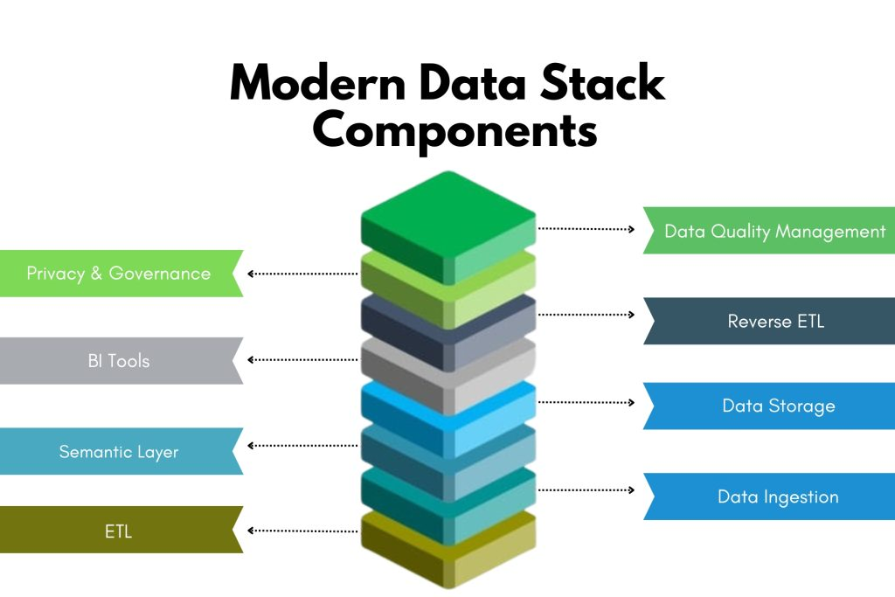
Data Warehouse Layer
Dividing the Data Warehouse Architecture into layers or stack components is crucial to manage the complexity of the system, ensure scalability, facilitate maintenance and enhancement, and optimize performance.
Add layers such as: Streaming Data Layer (for real-time data ingestion, e.g., Kafka, Kinesis).
Data Lake Layer (AWS S3, Google Cloud Storage).
Data Lakehouse Layer (Delta Lake, Apache Hudi).
Cloud Storage and Compute Layer (AWS Redshift, Google BigQuery, Snowflake)
[4]

Slide 5

Layers - 1. Organization and Management:
Modularity:
Each layer has a specific role and functionality, allowing for modular design and development. This modular approach makes it easier to manage, modify, and extend individual components without affecting the entire system.
Enhancements and Maintenance:
Division into layers facilitates easier enhancements and maintenance as changes or upgrades in one layer do not necessarily impact other layers if properly managed.
Microservices architecture: Microservices for modular data warehouse management, easily deployable via containerization (Docker, Kubernetes).
Serverless Architecture for Cost Optimization and Scalability in Cloud Environments refers to a modern cloud computing model where resources are automatically managed by the cloud provider, and users are charged only for the actual consumption of resources, rather than provisioning infrastructure upfront.

Slide 6
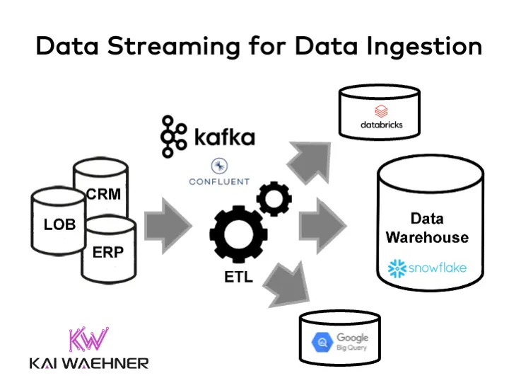
Layers - 2. Data Processing and Transformation
Data Integration and Transformation:
Having a dedicated layer for ETL (Extract, Transform, Load) processes ensures that data from various source systems is integrated and transformed consistently and efficiently before it is loaded into the Data Warehouse.
ETL and ELT in serverless cloud environments (AWS Glue, Talend Cloud, Fivetran)
real-time data integration and transformation, referencing tools like Apache Kafka and AWS Kinesis.
Data Quality and Consistency:
The staging layer can serve as a checkpoint for assessing and improving data quality and consistency, which is critical for reliable analytics and reporting.
[5]

Slide 7
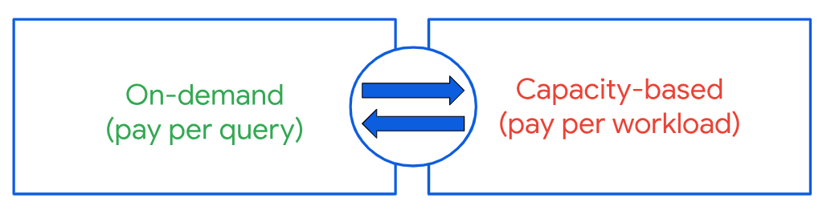
Layers - 3. Scalability and Performance
Optimization:
Different layers can be optimized independently for performance, allowing for the tuning of specific components, like optimizing the storage layer for query performance or the ETL layer for data processing speed.
Scalability:
A layered architecture can more easily accommodate scalability, allowing for the expansion of individual layers based on the growing needs, such as increasing the storage capacity or enhancing the processing power of the ETL layer.
Auto-scaling on cloud platforms (Snowflake's elastic scaling, BigQuery's on-demand pricing).

Slide 8

Layers - 4. Security and Access Control
Data Security:
Security measures can be implemented at appropriate layers to protect sensitive data, like encrypting data at rest in the storage layer and controlling access at the presentation layer.
Access Control:
Different layers can have varying levels of access control to ensure that users and applications only access the data and functionality they are authorized to use.
Fine-grained role-based access control across multiple layers using modern tools (AWS IAM, Azure Active Directory).

Slide 9

Layers - 5. Flexibility and Adaptability
Technology Independence:
Each layer can leverage the most suitable technologies and tools for its functions, allowing for flexibility and adaptability in technology choices.
Evolving Needs:
As organizational needs evolve, individual layers can be adapted, replaced, or extended without requiring a complete overhaul of the entire architecture.
Multi-cloud and hybrid architectures (AWS Outposts, Google Anthos, Azure Arc) that allow data to move seamlessly between on-prem and cloud environments.

Slide 10

Talend Data Integration
Talend, a leading data integration and data management platform, plays a crucial role in modern data warehouse architecture and infrastructure.
When it comes to implementing the layer concept in a data warehouse, Talend offers a variety of tools and features that align with the different layers of a typical data warehouse architecture.

Slide 11
1. Talend -Source Layer
Connectivity: Talend provides connectors to a vast number of source systems, including databases, flat files, cloud-based data sources, ERPs, CRMs, and many other systems.
Data Extraction: Talend can extract data from these sources and move it to the staging area of the data warehouse.

Slide 12
2. Talend - Staging Layer [1]
Temporary Storage: Talend can load extracted data into a staging area. This layer temporarily holds raw data from source systems, enabling further transformation.
Data Quality Checks: Using Talend, you can perform initial data quality checks to identify missing or inconsistent data.

Slide 13
3. ETL Layer [2]
Definition: Where Extraction, Transformation, and Loading of data take place.
Components: ETL tools like Informatica, Apache Nifi, Talend, etc.

Slide 14

4. Data Storage Layer
Change Data Capture (CDC): Talend supports CDC, which identifies and captures changes in source data, allowing for efficient incremental data loads.
Loading: Once data is transformed, Talend can load it into the data warehouse's main storage, whether it's an RDBMS, a columnar database, or a cloud-based data warehouse solution.

Slide 15

5. Data Presentation Layer
Semantic Layer: With Talend, you can create a semantic layer that provides an abstracted view of the data, making it more accessible for business users.
Data Marts: Talend can also help in populating data marts, which are subsets of data warehouses optimized for specific business functions.

Slide 16
6. Data Access Layer
APIs and Services: Talend allows for the creation of APIs and web services, facilitating data access for various applications and users.
Integration with BI Tools: The platform can integrate with various BI tools, ensuring that data in the presentation layer is readily available for reporting and analysis.

Slide 17
7. Metadata, Monitoring, and Management
Metadata Management: Talend provides metadata management capabilities, ensuring that data lineage, definitions, and transformations are documented.
Job Monitoring: The platform offers monitoring tools that allow for real-time tracking of ETL jobs, ensuring that data flows smoothly and errors are quickly identified.
Centralized Management: Talend Administration Center (TAC) provides a centralized dashboard for managing and monitoring data integration tasks.

Slide 18

Summary
In essence, Talend Data Integration offers a comprehensive suite of tools that align with and support the various layers of a data warehouse architecture.
By providing functionalities that span from source extraction to presentation, Talend enables businesses to efficiently build, manage, and utilize their data warehouse infrastructure.

Slide 19
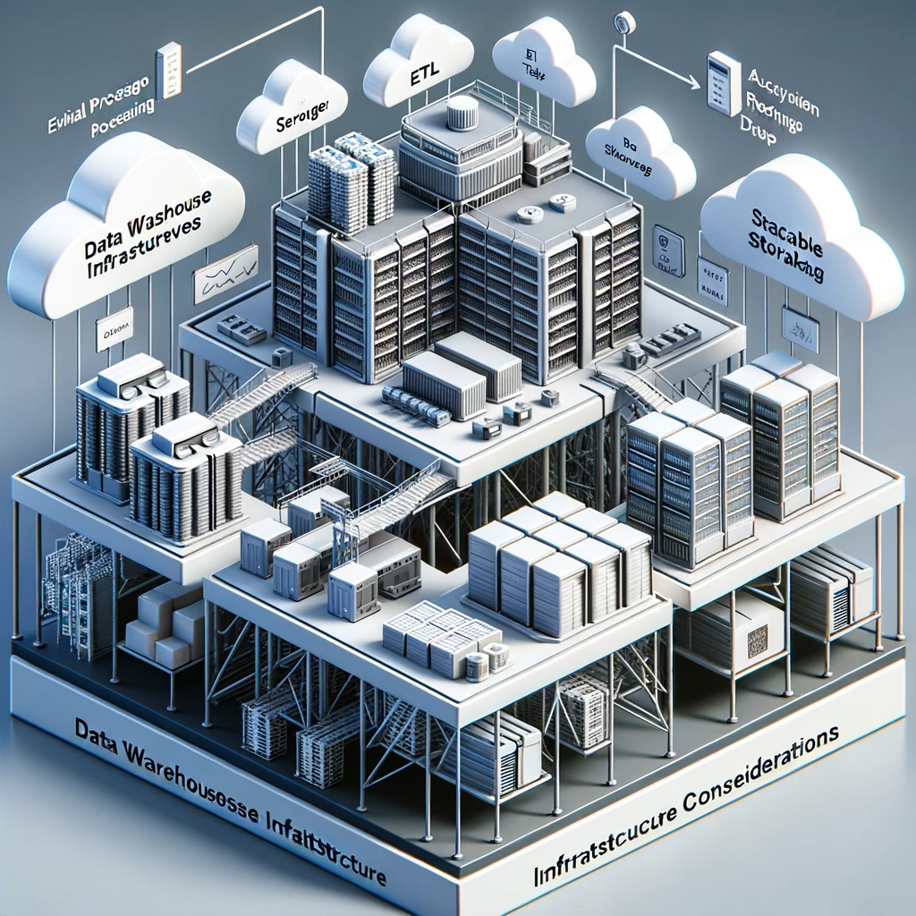
Infrastructure Considerations for data warehouse
1. Scalability:
To accommodate growing data volumes, the infrastructure should be scalable.
Solutions could be based on cloud platforms like AWS, Azure, or Google Cloud, which offer scalable storage and compute resources.
2. Performance:
Infrastructure should support high-performance data processing and query execution.
This involves optimizing storage, choosing appropriate hardware, and leveraging caching mechanisms.
3. Security:
Infrastructure should be secure to protect sensitive data from unauthorized access and breaches.
Implementing firewalls, encryption, and access controls are crucial.

Slide 20

Infrastructure Considerations for data warehouse
4. Cost:
Infrastructure costs should be optimized to avoid overprovisioning of resources.
Monitoring and optimizing resource usage and choosing cost-effective storage and compute options are essential.
5. High Availability and Disaster Recovery:
Data Warehouse should be available for users and resilient to failures.
Implementing redundancy, backups, and recovery mechanisms are essential.
6. Technology Choices:
The choice of technology, tools, and platforms impacts the functionality, performance, and usability of the Data Warehouse.
This includes choosing the appropriate database technologies, ETL tools, BI tools, and platforms.

Slide 21

A star schema plays a crucial role in data warehouse architecture and infrastructure
Basic Structure: A star schema is characterized by one or more fact tables referencing any number of dimension tables. The fact table contains quantitative data (like sales amounts), and the dimension tables contain descriptive, textual or categorical information (like product name or date).
Performance: Star schemas are optimized for query performance. Since data warehouses are typically used for analytical processing and complex querying, the star schema provides an efficient, denormalized structure that allows for simpler and faster queries.
Simplicity: For end-users, especially those using business intelligence tools, star schemas are intuitive and easy to understand. Users can quickly comprehend the relationship between tables and write queries without having to join many tables.

Slide 22

A star schema plays a crucial role in data warehouse architecture and infrastructure
ETL Process: In a data warehouse, data is often loaded from various source systems. The ETL (Extract, Transform, Load) process can be streamlined when the target is a star schema. The transformations and aggregations required are often simpler and more straightforward.
Aggregation: Fact tables in star schemas often store aggregated data, which is suitable for analytical querying. For example, a fact table might store daily sales rather than individual transactions.
Flexibility: Star schemas are flexible and can easily accommodate changes like adding new dimensions or new measures in the fact table.

Slide 23
A star schema plays a crucial role in data warehouse architecture and infrastructure
Data Warehouse Architecture Components: A data warehouse might have multiple star schemas for different subject areas. These individual star schemas can then be integrated into a larger galaxy or snowflake schema if required.
Data Marts: Often, a subset of a data warehouse, called a data mart, is built for a specific business area or team. A data mart typically uses a star schema because of its simplicity and performance benefits.
Scalability: Star schemas can be scaled up as the data grows. With the rise of columnar databases and MPP (Massively Parallel Processing) architectures, star schemas can provide excellent performance even with massive amounts of data.

Slide 24
A star schema plays a crucial role in data warehouse architecture and infrastructure
Integration with BI Tools: Many Business Intelligence (BI) tools have built-in support for star schemas, making it easier for analysts and business users to create reports and dashboards.
In summary, star schema is a fundamental concept in data warehousing that supports the architecture and infrastructure by providing an optimized, user-friendly, and scalable design for data storage and querying.

Slide 25

Here are some good tips to draw a star schema
Understand the business requirements and the questions that need to be answered through the data warehouse. This will help you determine the necessary dimensions and facts for your star schema.
Choose a central fact table that contains the core data you want to analyse. This table typically contains quantitative data, such as sales revenue, order quantities, or customer counts.
Determine the dimension tables that provide context to the data in the fact table. Dimensions are attributes by which you want to slice and dice the data. For example, in a sales database, dimensions might include time, product, customer, and location.

Slide 26

Here are some good tips to draw a star schema
Within dimension tables, define hierarchies. Hierarchies help in organizing dimension attributes in a tree-like structure. For example, a time dimension might have hierarchies like year > quarter > month > day.
Ensure that each dimension table has a primary key, which uniquely identifies each row. The fact table should have foreign keys that link to the dimension tables. These keys are crucial for establishing relationships between the fact and dimension tables.
Whether you need to include the customer name in the customer dimension table of a star schema depends on your specific business requirements and use cases. Here are some factors to consider when deciding whether to include customer name in the customer dimension table.

Slide 27

Here are some good tips to draw a star schema
Consider whether there are analytical requirements that involve the customer's name. If you anticipate that you will often need to analyse data by customer name (e.g., for customer-specific reporting or segmentation), including it in the dimension table can be beneficial.
Including the customer's name in the dimension table adds storage overhead, especially if you have a large number of customers. It can also affect query performance. Consider the trade-off between storage requirements and query performance when making your decision.
Assess whether the source data systems provide customer names directly or if they are easily joinable with customer identifiers (e.g., customer IDs) to retrieve names when needed. If names are readily available from source systems, you may not need to store them redundantly in the dimension table.

Slide 28
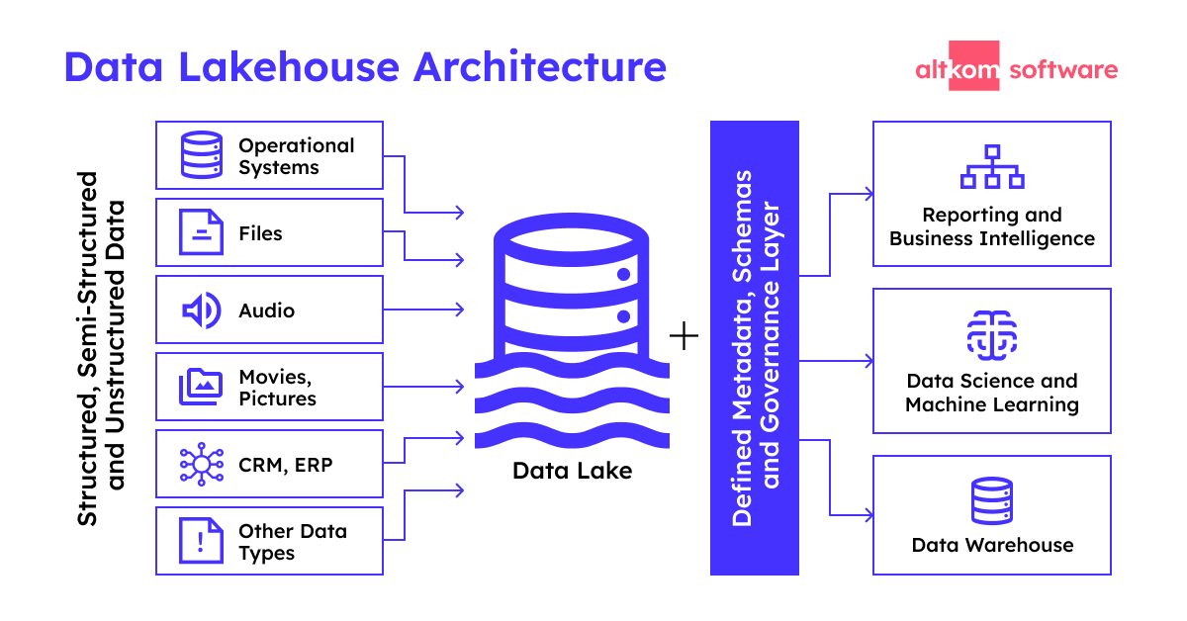
Lakehouse Architecture: Merging Data Lakes and Data Warehouses
[7]
Lakehouse Architecture is a modern approach to data management that combines the benefits of both data lakes and data warehouses.
It seeks to overcome the limitations of traditional data architectures by unifying data storage, management, and analytics in one system, providing both the flexibility of data lakes and the performance of data warehouses.

Slide 29
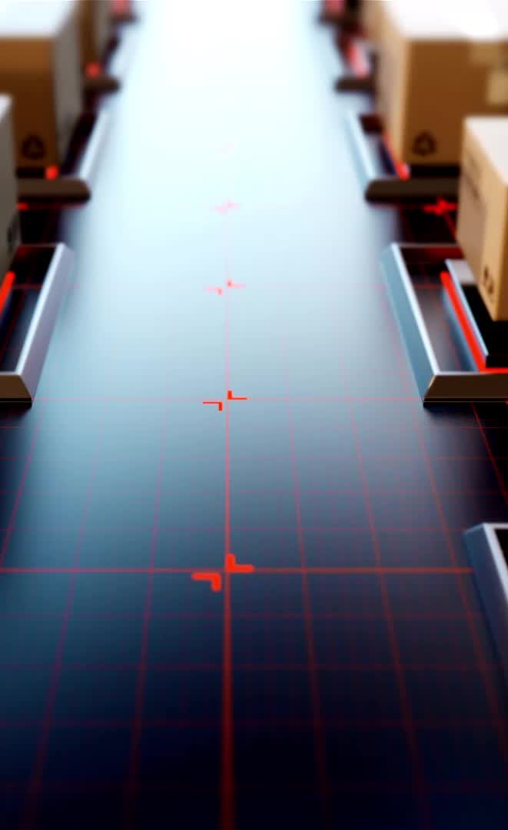
Conclusion
When designing a Data Warehouse Architecture and Infrastructure, it is important to ensure that it meets the organization's current and future needs, is scalable, performs well, and is secure and cost-effective.
Leveraging modern technologies and platforms can help in building a robust and efficient Data Warehouse system.

Slide 30
Lab Exercise - Data Warehouses Using Talend Data Integration
Objective:
By the end of this lab, participants will be familiar with the basic features of Talend Data Integration for creating a simple data warehouse, including data extraction, transformation, and loading (ETL) processes.

Slide 31
Task 1: Extract data from the provided CSV file
Open Talend Data Integration Studio:
Launch the Talend Data Integration tool and open your project.
Create a New Job:
Right-click in the Repository panel on the left under Job Designs.
Choose Create job.
Provide a name for the job (e.g., "CSV_Extraction") and a description, if desired. Click Finish.
Add a tFileInputDelimited Component:
This component is used to read delimited files like CSV.
From the Palette panel on the right, type "tFileInputDelimited" into the search bar.
Drag the tFileInputDelimited component to the design workspace.

Slide 32
Task 1: Extract data from the provided CSV file
Configure the tFileInputDelimited Component:
Click on the tFileInputDelimited component to select it.
In the Component panel below, set the properties:
File Name/Stream: Browse to and select your CSV file.
Row Separator: Set this to "\n" for new lines (most common for CSV files).
Field Separator: Set this to "," depending on how your CSV is delimited.
Header: If your CSV has a header row, set this to 1. .
Under the Schema section, click on the Edit schema button. Here, define the columns in your CSV file by adding columns and specifying their data types. This schema should match the structure of your CSV file.
Run the Job to View Data:
To view the extracted data from the CSV, you can use the tLogRow component.
Drag the tLogRow component from the Palette to the workspace.
Connect tFileInputDelimited to tLogRow by right-clicking on tFileInputDelimited, selecting Row > Main, and then clicking on tLogRow.
Now, click on the Run tab at the bottom and press the Run button.
The extracted data from the CSV file should be displayed in the console.

Slide 33

Task 2: Transform the data by filtering out records with missing values
Create a new job:
Click on File -> New -> Job.
Provide a name for the job, e.g., "FilterMissingValues".
Setup the components:
Drag and drop the tFileInputDelimited component from the Palette onto the workspace. This component is used to read the CSV file.
Drag and drop the tFilterRow component. This component is used to filter rows based on conditions.
Drag and drop the tFileOutputDelimited component. This will be used to save the filtered results to a new CSV file.

Slide 34
Task 2: Transform the data by filtering out records with missing values
Configure tFileInputDelimited:
Double-click on tFileInputDelimited.
Set the file path to your CSV file location.
Define the CSV format, e.g., delimiter as ",".
Click on the Edit schema button and define the columns, their data types, and lengths according to the CSV file.
Link tFileInputDelimited to tFilterRow:
Right-click on tFileInputDelimited -> Row -> Main and connect it to tFilterRow.

Slide 35
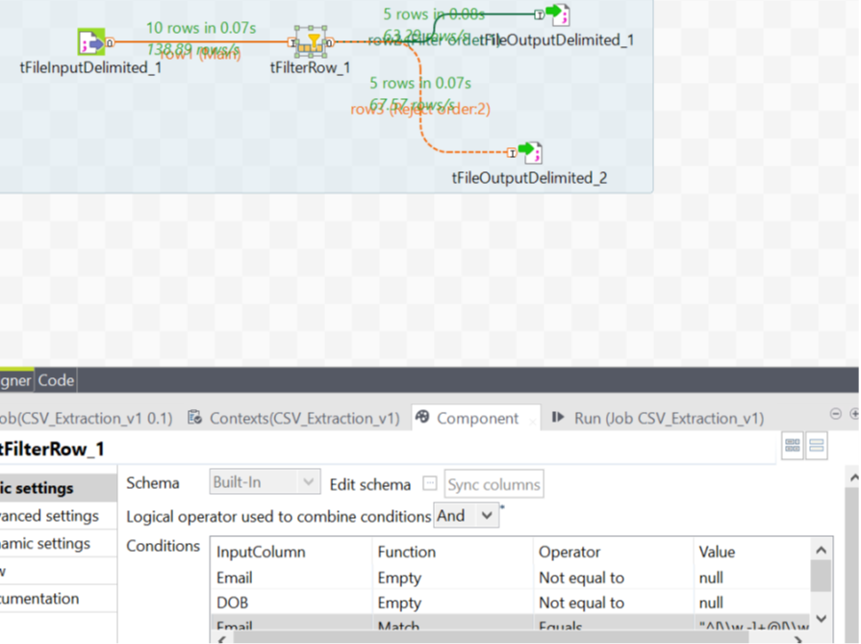
Task 2: Transform the data by filtering out records with missing values
Configure tFilterRow:"^[\\w.-]+@[\\w.-]+\\.[a-zA-Z]{2,6}$“ for valid e-mail
Double-click on the tFilterRow component.
In the "Condition" section, set up the filters for each column where missing values need to be removed.
For example, if "Email" column shouldn't be empty: Column: Email, Function: !=, Value: "".
Do this for every column that should not have missing values.
Link tFilterRow to tFileOutputDelimited:
Right-click on tFilterRow -> Row -> Filter (for passing records) and connect it to tFileOutputDelimited.

Slide 36
Task 2: Transform the data by filtering out records with missing values
Configure tFileOutputDelimited:
Double-click on the component.
Set the file path where you want to save the filtered data.
Ensure the output schema matches the input schema.
Define the CSV format, e.g., delimiter as ",".
Run the job:
Save your job.
Click on the "Run" tab at the bottom.
Click on the "Run" button.
The job will process the CSV file, filter out rows with missing values, and save the clean data to a new CSV file.

Slide 37
Task 3: Using tMap to Join Datasets
Input Data: Drag and drop tFileInputDelimited components from the palette onto the workspace for both CSV files.
Configure each component to point to the respective CSV files (task1_customers.csv and country_regions.csv).
Ensure you define the schema correctly for each CSV.
tMap Configuration:
Drag and drop a tMap component onto the workspace.
Link both tFileInputDelimited components to the tMap component.
Double click the tMap component to open its editor.
Joining Data:
On the left side of the tMap editor, you will see the two input datasets.
Drag the 'Country' column from task1_customers to the 'Country' column of country_regions to create a join.
On the right side of the tMap editor, define your output structure. You'll likely want to include all columns from task1_customers and the 'CountryRegion' column from country_regions

Slide 38
Task 3: Using tMap to Join Datasets and load the resulting data into a new CSV file
Output Configuration:
Drag and drop a tFileOutputDelimited component onto the workspace.
Link the output from the tMap component to the tFileOutputDelimited component.
Configure the output component to write the results to a new CSV file, say, joined_data.csv.
Run the Job: Once everything is set up, click on the Run button to execute the ETL job. After successful execution, you should have a new CSV file that contains the customer data along with their respective country regions.

Slide 39
References
[1] http://bekwam.blogspot.com/2011/02/staging-data-for-etl-processing-with.html
[2] https://digital-geography.com/fme-and-talend-etl-tools-for-your-spatial-data/
[3] https://www.javatpoint.com/talend-centralizing-excel-file-metadata
[4] https://www.protecto.ai/blog/understanding-modern-data-stack
[5] https://kai-waehner.medium.com/data-streaming-for-data-ingestion-into-the-data-warehouse-and-data-lake-6a1bdd39226c
[6] https://cloud.google.com/bigquery/docs/reservations-intro
[7] https://www.altkomsoftware.com/blog/data-architecture/

